Slide 1
CSC 112: Computer Operating Systems Lecture 3 Synchronization
Department of Computer Science,
Hofstra University
Acknowledgement: Lecture slides based on UC Berkeley CS 162: Operating Systems and System Programming
And NTNU course on Operating Systems

Slide 2
Concurrency I
int x = 0;
//Thread T0
for (int i=0; i<5; i++) {
x = x + 1;
}
//Thread T0
for (int j=0; j<5; j++) {
x = x + 2;
}
Consider two concurrent threads T0, T1, which access a shared variable x that has been initialized to 0. There is no mutex protection.
Q1: What are the minimum, maximum, and all possible values of x after the two threads have completed execution?
Q2: Suppose we protect statement ‘x = x+2’ in Thread B within a critical section using a mutex lock. What are all the minimum, maximum, and all possible final values of x?
Notes:
for (i=0; i

Slide 3
Concurrency I Answer
int x = 0;
//Thread T0
for (int i=0; i<5; i++) {
x = x + 1;
}
//Thread T0
for (int j=0; j<5; j++) {
x = x + 2;
}
ANS1: Possible values of x after the two threads have completed execution: 5,…15. Min: 5. Max: 15.
The x=x+2 statements can be “erased” by being between the load and store of an x=x+1 statement, and vice versa. Each x=x+1 statement can either do nothing (if erased by Thread T1) or increase x by 1. Each x=x+2 statement can either do nothing (if erased by Thread T0) or increase x by 2. Since there are at least four stores from Thread T0 prior to the load for the last statement, the last load reads x value of at least 4. Since there are 5 of each type, and since x starts at 0, x has min 5 and max (5*1)+(5*2)=15. Possible values are 5, 6, 7,…15, e.g., If three increments from Thread T0 and two increments from Thread T1 are applied, then x=(3×1)+(2×2)=7.
ANS2: Possible final values of x are 5, 7, 9, 11, 13, or 15. Min: 5. Max: 15.
Since the x=x+2 statements are atomic, the x=x+1 statements can never be “erased” because the load and store phases of x=x+2 cannot be separated. Thus, our final value is at least 5 (from Thread T0) with from 0 to 5 successful updates of x=x+1. When one x=x+2 is not erased, x has value 5+2=7. When two x=x+2 is not erased, x has value 5+4=9, and so on.
Notes:
for (i=0; i

Slide 4
Concurrency II
Consider three concurrent threads T1, T2, T3, which access a shared variable D that has been initialized to 100. There is no mutex protection. What are the minimum and maximum possible values of D after the three threads have completed execution?
ANS:
//Initialization
int D=100;
//Thread T1
void main(){
D=D+20;
}
//Thread T2
void main(){
D=D-50;
}
//Thread T3
void main(){
D=D+10;
}

Slide 5
Concurrency II Answer
Min 50, max 130
Since each thread may read the value of int D, then write them in arbitrary order, overwriting each other’s updates. Other possible results include 110, 120, 70…

Slide 6
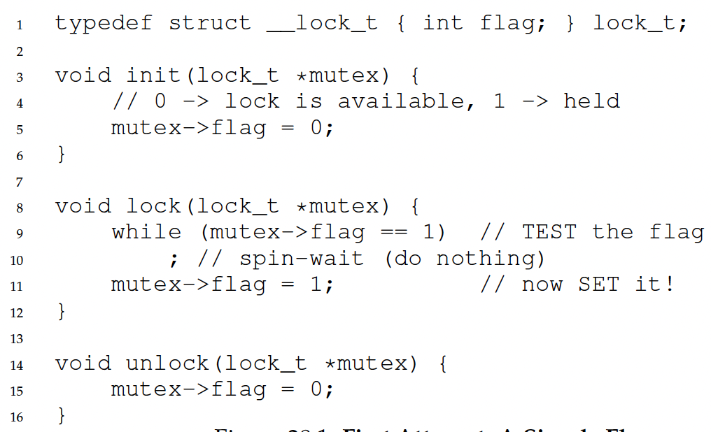
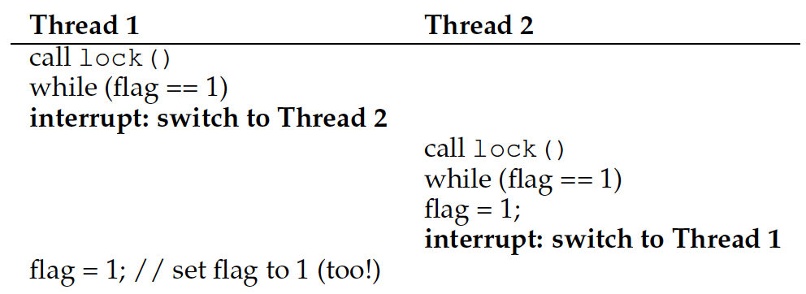
Recall: Locks: Loads/Stores
This implementation does not ensure mutual exclusion, since both threads may grab the lock:
After Thread 1 reads flag==0 and exits the while loop, it is preempted/interrupted by Thread 2, which also reads flag==0 and exits the while loop. Then both threads set flag=1 and enter the critical section.
Root cause: Lock is not an atomic operation!
flag = 0
Notes:
Another problem: performance overhead!

Slide 7
Mutual Exclusion I
Boolean S0, S1;
S0=false, S1=false;
//Thread T0
while (true) {
//Spin-waits if S0 == S1
while (S0 == S1);
//Critical section
S0 = S1;
}
//Thread T1
while (true) {
//Spin-waits if S0 != S1
while (S0 != S1);
//Critical section
S1 = !S0;
}
Does it achieve one of more of the correctness properties of a concurrent program:
Mutual exclusion: Only one thread in critical section at a time
Progress (deadlock-free): If several simultaneous requests, must allow one to proceed
Bounded waiting (starvation-free): Must eventually allow each waiting thread to enter
Does it need the TestAndSet() instruction for atomic execution like the previous slide “Locks: Loads/Stores”?
What is its major flaw?
ANS:
Notes:
Consider the methods used by threads T1 and T2 for accessing their critical sections whenever needed, as given below. (These are the only methods for accessing the critical section, and T1 and T2 each runs a separate higher-level program that uses these methods which is not shown.) The initial values of S1 and S2 are arbitrary.
Which of the following is true?
(a) Mutual exclusion but not progress
(b) Progress but not mutual exclusion
(c) Neither mutual exclusion nor progress
ANS:
acd

Slide 8
Mutual Exclusion I: Sample Execution
Boolean S0, S1;
S0=false, S1=false;
 | S0 | S1
Init | F | F
T1 in CS
 | F | T
T0 in CS
 | T | T
T1 in CS
 | T | F
T0 in CS
 | F | F
//Thread T0
while (true) {
while (S0 == S1);
//Critical section
S0 = S1;
}
//Thread T1
while (true) {
while (S0 != S1);
//Critical section
S1 = !S0;
}
T0 and T1 take turns to enter the critical section in strict alternation order .
Notes:
Consider the methods used by threads T1 and T2 for accessing their critical sections whenever needed, as given below. (These are the only methods for accessing the critical section, and T1 and T2 each runs a separate higher-level program that uses these methods which is not shown.) The initial values of S1 and S2 are arbitrary.
Which of the following is true?
(a) Mutual exclusion but not progress
(b) Progress but not mutual exclusion
(c) Neither mutual exclusion nor progress
ANS:
acd

Slide 9
Mutual Exclusion I Answer
Mutual Exclusion: Achieved. Only one thread can enter its critical section at a time because the conditions S0 == S1 and S0 != S1 ensure that only one thread can proceed.
Progress (Deadlock-Free): Achieved. It is not possible for each thread to be blocked forever waiting for each other.
Bounded Waiting (Starvation-Free): Achieved. Both threads enter each one’s critical section in strict alternation order, i.e., T0, T1, T0, T1…
TestAndSet Instruction: Not required. The solution uses simple Boolean variables and logical operations. In the previous slide “Locks: Loads/Stores”, all threads read and update a single global shared flag variable, so CPU atomic instructions like TestAndSet is needed to ensure atomicity of (read+modify+write) of the shared flag variable. But in this solution, each thread reads both S0 and S1, but T0 only updates S0 and T1 only updates S1, so no mutual exclusion is needed.
Major Flaw: The algorithm relies on both threads actively participating in strict alternation order, i.e., T0, T1, T0, T1… If one thread stops due to some program bug or crashing, or is delayed indefinitely, the other thread might be blocked forever, leading to a potential deadlock. This may not happen for the example of two simple while loops, but it is just for illustration, whereas in reality each thread may run a large program with complex control flow, and use these instructions as lock/unlock instructions.
Notes:
Not guaranteed.
Not satisfied. There is no mechanism to ensure that a thread waiting to enter its critical section will eventually proceed, e.g., if the other thread stops.

Slide 10
Mutual Exclusion II
Boolean flag[2];
flag[0]=false, flag[1]=false;
//Thread T0
while (true) {
flag[0] = true;
while (flag[1]==true);
/* Critical Section */
flag[0] = false;
}
//Thread T1
while (true) {
flag[1] = true;
while (flag[0]==true);
/* Critical Section */
flag[1] = false;
}
Does it achieve one of more of the correctness properties of a concurrent program:
Mutual exclusion: Only one thread in critical section at a time
Progress (deadlock-free): If several simultaneous requests, must allow one to proceed
Bounded waiting (starvation-free): Must eventually allow each waiting thread to enter
ANS:
Notes:
Boolean flag[2] = {false, false};
// Thread T0
while (true) {
flag[0] = true;
while (flag[1] == true);
/* Critical Section */
flag[0] = false;
}
// Thread T1
while (true) {
flag[1] = true;
while (flag[0] == true);
/* Critical Section */
flag[1] = false;
}

Slide 11
Mutual Exclusion II: Sample Execution & Answer
Boolean flag[2];
flag[0]=false, flag[1]=false;
 | Flag[0] | Flag[1]
Init | F | F
T0 tries | T | F
T0 in CS
 | F | F
T1 tries | F | T
T1 in CS
 | F | F
T0 tries | T | F
T1 tries | T | T
Deadlock
//Thread T0
while (true) {
flag[0] = true;
while (flag[1]==true);
/* Critical Section */
flag[0] = false;
}
//Thread T1
while (true) {
flag[1] = true;
while (flag[0]==true);
/* Critical Section */
flag[1] = false;
}
Mutual Exclusion: Achieved. The use of flags ensures that only one thread can enter its critical section at a time.
Progress (Deadlock-Free): Not satisfied. If both threads set their flags simultaneously, they will block each other indefinitely, resulting in deadlock.
Bounded Waiting (Starvation-Free): Achieved. One thread cannot repeatedly enter the CS and starve the other thread, if the other thread is waiting.
Notes:
Once a thread exits its critical section, it resets its flag to false, allowing the other thread to proceed.
This ensures that no thread can repeatedly enter the CS and starve the other, provided both threads are actively trying to access the CS.
Boolean flag[2] = {false, false};
// Thread T0
while (true) {
flag[0] = true;
while (flag[1] == true);
/* Critical Section */
flag[0] = false;
}
// Thread T1
while (true) {
flag[1] = true;
while (flag[0] == true);
/* Critical Section */
flag[1] = false;
}

Slide 12
Mutual Exclusion III (Peterson’s Solution)
Boolean flag[2];
flag[0]=false, flag[1]=false;
int turn = 0;
//Thread T0
while (true) {
flag[0] = true;
turn = 1;
while (flag[1]==true && turn==1);
/* Critical Section */
flag[0] = false;
}
//Thread T1
while (true) {
flag[1] = true;
turn = 0;
while (flag[0]==true && turn==0);
/* Critical Section */
flag[1] = false;
}
Does it achieve one of more of the correctness properties of a concurrent program:
Mutual exclusion: Only one thread in critical section at a time
Progress (deadlock-free): If several simultaneous requests, must allow one to proceed
Bounded waiting (starvation-free): Must eventually allow each waiting thread to enter
ANS:
Notes:
int i=0, j=1;

Slide 13
Mutual Exclusion III (Peterson’s Solution): Sample Execution & Answer
Mutual Exclusion: Achieved. The combination of flag and turn ensures that only one thread can enter its critical section at a time.
Progress (Deadlock-Free): Achieved. The turn variable ensures that if both threads want to enter their critical sections, one will eventually proceed. It is not possible for each thread to be blocked forever waiting for each other.
Bounded Waiting (Starvation-Free): Achieved. Each thread gets a fair chance to enter its critical section due to the alternation enforced by the turn variable.
 | Flag[0] | Flag[1] | turn
Init | F | F | 0
T0 tries | T | F | 1
T0 in CS
 | F | F | 1
T1 tries | F | T | 0
T1 in CS
 | F | F | 0
T0 tries | T | F | 1
T1 tries | T | T | 0
T0 in CS | (T1 cannot enter CS)
 | F | T | 0
T0 tries | T | T | 1
T1 in CS | (T0 cannot enter CS)
 | T | F | 1

Slide 14
Mutual Exclusion III (Peterson’s Solution Variation)
Boolean flag[2];
flag[0]=false, flag[1]=false;
int turn = 0;
//Thread T0
while (true) {
flag[0] = true;
turn = 0;
while (flag[1]==true && turn==1);
/* Critical Section */
flag[0] = false;
}
//Thread T1
while (true) {
flag[1] = true;
turn = 1;
while (flag[0]==true && turn==0);
/* Critical Section */
flag[1] = false;
}
Does it achieve one of more of the correctness properties of a concurrent program:
Mutual exclusion: Only one thread in critical section at a time
Progress (deadlock-free): If several simultaneous requests, must allow one to proceed
Bounded waiting (starvation-free): Must eventually allow each waiting thread to enter
ANS:
Notes:
int i=0, j=1;

Slide 15
Mutual Exclusion III (Peterson’s Solution Variation) Sample Execution & Answer
 | Flag[0] | Flag[1] | turn
Init | F | F | 0
T0 tries | T | F | 0
T0 in CS
 | F | F | 0
T1 tries | F | T | 1
T1 in CS
 | F | F | 1
T0 tries | T | F | 0
T1 tries | T | T | 1
T1 in CS
 | T | F | 1
T1 tries | T | T | 1
T1 in CS
 | T | F | 1
T0 experiences starvation
This variation is similar to Peterson's Solution but with an incorrect implementation of the turn variable:
Mutual Exclusion: Achieved. Only one thread can enter its critical section at a time due to the conditions on flag and turn.
Progress (Deadlock-Free): Achieved. It is not possible for each thread to be blocked forever waiting for each other.
Bounded Waiting (Starvation-Free): Not satisfied. A thread may be indefinitely delayed if the other repeatedly sets its flag and does not allow alternation via the turn variable, i.e., one thread can repeatedly enter the CS and starve the other thread.
TestAndSet Instruction: Not required.
Major Flaw: Incorrect handling of the turn variable leads to potential livelock or starvation.

Slide 16
Readers/Writers Solution using Monitors, Prefers Writers
int AR=0: Number of active readers;
int WR=0: Number of waiting readers;
int AW=0: Number of active writers;
int WW=0: Number of waiting writers;
Condition okToRead, okToWrite;
mutex_t mutex = 1;
Q: Rewrite it to prefer readers
Reader() { mutex_lock(&mutex);
while ((AW + WW) > 0) {//Is it safe to read? WR++; //No. Writers exist cond_wait(&okToRead,&mutex); WR--; //No longer waiting }
AR++; //Reader active! mutex_unlock(&mutex);
AccessDatabase(ReadOnly);
mutex_lock(&mutex); AR--; //No longer active if (AR == 0 && WW > 0)//No other active readers cond_signal(&okToWrite);//Wake up one writer mutex_unlock(&mutex); }
Writer() { mutex_lock(&mutex);
while ((AW + AR) > 0) {//Is it safe to write? WW++; //No. Active users exist cond_wait(&okToWrite,&mutex); WW--; //No longer waiting }
AW++; //Writer active! mutex_unlock(&mutex); AccessDatabase(ReadWrite);
mutex_lock(&mutex); AW--; //No longer active if (WW > 0){//Give priority to writers cond_signal(&okToWrite);//Wake up one writer } else if (WR > 0) {//Otherwise, wake reader cond_broadcast(&okToRead);//Wake all readers } mutex_unlock(&mutex); }
16

Slide 17
Readers/Writers Solution using Monitors, Prefers Writers
int AR=0: Number of active readers;
int WR=0: Number of waiting readers;
int AW=0: Number of active writers;
int WW=0: Number of waiting writers;
Condition okToRead, okToWrite;
mutex_t mutex = 1;
ANS: Rewrite it to prefer readers
Reader() { mutex_lock(&mutex);
while (AW > 0) {//Is it safe to read? WR++; //No. Writers exist cond_wait(&okToRead,&mutex); WR--; //No longer waiting }
AR++; //Reader active! mutex_unlock(&mutex);
AccessDatabase(ReadOnly);
mutex_lock(&mutex); AR--; //No longer active if (AR == 0 && WW > 0)//No other active readers cond_signal(&okToWrite);//Wake up one writer mutex_unlock(&mutex); }
Writer() { mutex_lock(&mutex);
while ((AW + AR) > 0) {//Is it safe to write? WW++; //No. Active users exist cond_wait(&okToWrite,&mutex); WW--; //No longer waiting }
AW++; //Writer active! mutex_unlock(&mutex); AccessDatabase(ReadWrite);
mutex_lock(&mutex); AW--; //No longer active if (WR > 0) {//Wake all readers cond_broadcast(&okToRead);//Wake all readers } else if (WW > 0){Otherwise, wake one writer cond_signal(&okToWrite);//Wake up one writer } mutex_unlock(&mutex); }
17

Slide 18
Race Conditions
Consider the two threads each executing t1 and t2. Values of shared variables y and z are initialized to 0
int y=0, z=0;
1 t1(){ |  |  | 1 | t2(){
2 | int x; |  | 2 |  | y = 1;
3 | x = y + z; |  | 3 |  | z = 2;
4 } |  |  | 4 | }
Q. Give all possible final values for x and the corresponding order of execution of instructions in t1 and t2.
1) t1 runs to the end first; then t2 runs to the end: x = 0+0 = 0
2) t2 to line 2; then t1 to the end; then t2 to the end: x = 1+0 = 1
3) t2 to the end; then t1 to the end: x = 1+2 = 3
Are there other possibilities giving additional values?
18

Slide 19
Race Conditions
Addition operation x=y+z consist of multiple machine instructions in assembly language:
fetch operand y into register r1
fetch operand z into register r2
add r1 + r2, store result in r3
store r3 in memory location of x
If a task switch to t2 occurs between machine instructions A and B; then t2 runs to completion before switching back to t1, then:
y is read as 0 (t2 didn’t set y yet)
z is read as 2 (t2 sets z before execution instruction B of add. in t1)
the sum is then x = 0 + 2 = 2
int y=0, z=0;
1 t1(){ |  |  | 1 | t2(){
2 | int x; |  | 2 |  | y = 1;
3 | x = y + z; |  | 3 |  | z = 2;
4 } |  |  | 4 | }
19

Slide 20
Race Conditions
Q. Give a solution using semaphores.
Solution: we protect the addition x = y + z within a critical section, using a binary semaphore (mutex). This code guarantees that x can never have the value 1 or 2, possible values are x = 0, 3
(Line “int x” can be outside or inside the critical section with no difference. We use a slightly different notation of s.wait()/s.signal() to denote sem_wait(&s) and sem_post(&s).
int y=0, z=0;
semaphore s = 1;
1 t1() { |  | 1 t2() {
2 | int x; | 2 s.wait();
3 | s.wait(); | 3 y = 1;
4 | x = y + z; | 4 z = 2;
5 | s.signal(); | 5 s.signal();
6 } |  | 6 }
20

Slide 21
Semaphores I
t1:
1 int t1() { |  | t2: | 1 int t2() {
2 | printf("w"); |  | 2 | printf("o");
3 | printf("d"); |  | 3 | printf("r");
4 } |  |  | 4 | printf("l");
 |  |  | 5 6 } | printf("e");
Q. Use semaphores and insert wait/signal calls into the two threads so that only “wordle” is printed.
semaphore s1=1, s2=0
1 int t1(){
1 int t2(){
t1 has to run first to print "w", so s1 should be initialized to 1.
t2 has to wait until the "w" has been printed by t1, then it is woken up by t1 calling s2.signal(), so s2 should be initialized to 0.
2
3
4
5
6
7
8 }
s1.wait();
2
3
4
5
6
7
8
9 }
s2.wait();
printf("o");
printf("r");
s1.signal();
s2.wait();
printf("l");
printf("e");
printf("w");
s2.signal();
s1.wait();
printf("d");
s2.signal();
21
Notes:
It is signalled by t1, so the initial value of s2 has to be 0.

Slide 22
Semaphores II
The following three functions of a program f1(), f2(), f3() run in separate threads each and print some prime numbers. All three threads are ready to run at the same time. Use synchronization using the semaphores S1, S2 and S3 and wait/signal operations on the semaphores to ensure that the program outputs the prime numbers in increasing order (2, 3, 5, 7, 11, 13).
Semaphore S1=0;
Semaphore S2=0;
Semaphore S3=0; f1() {
printf("3");
printf("5");
}
f2() {
printf("2");
printf("13");
}
f3() {
printf(“7");
printf("11");
}
Notes:
Insert appropriate wait or signal operations in the code lines indicated with // SYNC and give the correct initial values for the semaphores. Give the completed functions and the initial values for the semaphores.
Hint: Note that it might not be required to add a wait or signal operations in all of the places indicated.

Slide 23
Semaphores II Solution
semaphore S1=0;
semaphore S2=0;
semaphore S3=0;
f1() {
S1.wait();
printf("3");
printf("5");
S3.signal();
}
f2() {
printf("2");
S1.signal();
S2.wait();
printf("13");
}
f3() {
S3.wait();
printf("7");
printf("11");
S2.signal();
}
semaphore S1=0;
semaphore S2=1;
semaphore S3=0;
f1() {
S1.wait();
printf("3");
printf("5");
S3.signal();
}
f2() {
S2.wait();
printf("2");
S1.signal();
S2.wait();
printf("13");
}
f3() {
S3.wait();
printf("7");
printf("11");
S2.signal();
}
Solution 1 (left): With initial values of all semaphores = 0, only f2 can run, prints 2, signals S1 and then waits for S2. S1.signal() starts f1, which was waiting for S1 and can now print 3 and 5 and then signal S3. S3.signal() now starts f3, which prints 7 and 11 and signals S2. This returns execution to f2, which can then finally print 13.
Solution 2 (right): s2 has initial value 1, so f2 calls S2.wait() and runs first. The rest of the same as Solution 1. You can see that initializing s2=0 has the same effect as initializing s2=1 and let f2 call S2.wait() first. So Solution 1 is better with one less call to wait().
Notes:
Insert appropriate wait or signal operations in the code lines indicated with // SYNC and give the correct initial values for the semaphores. Give the completed functions and the initial values for the semaphores.
Hint: Note that it might not be required to add a wait or signal operations in all of the places indicated.

Slide 24
Semaphores III
semaphore s_a=0, s_b=0, s_c=0;
int t3() {
while(1) {
s_c.wait();
s_c.wait();
printf("C");
s_a.signal();
s_b.signal();
8 }
9 }
int t1() {
while(1) {
printf("A");
s_c.signal();
s_a.wait();
6 }
7 }
int t2() {
while(1) {
printf("B");
s_c.signal();
s_b.wait();
6 }
7 }
Q. Which strings can be output when running the 3 threads in parallel?
Either t1 or t2 could start first, so the first letter can be A or B
Then both t1 and t2 signal s_c, only after both have signalled s_c, t3 can start and print C
t3 signals s_a and s_b, which start in arbitrary order again
Accordingly, the output is a regular expression ((AB|BA)C)+
Print A or B in arbitrary order, then print C, then the process repeats
24
Notes:
Here, we have used a regular expression to indicate the structure of a text pattern. Regular expressions (short: regexps) are a common tool in Unix

Slide 25
Deadlocks I
//Initialization
int x=0, y=0, z=0; semaphore lock1=1, lock2=1;
//Initialization
int x=0, y=0, z=0; semaphore lock1=1, lock2=1;
1 int t1() {
2 z = z + 2;
lock1.wait();
x = x + 2;
lock2.wait();
lock1.signal();
y = y + 2;
lock2.signal();
9 }
1 int t2() {
1 int t1() { 1 int t2() {
2
3
lock2.wait();
2
3
4
5
6
7
8
9 }
z = z + 2; lock1.wait(); x = x + 2;
2
3
4
5
6
7
8
9 }
lock2.wait();
y = y + 1; lock1.wait(); x = x + 1;
lock1.signal(); lock2.signal(); z = z + 1;
y = y + 1; lock1.wait(); x = x + 1;
lock1.signal(); lock2.signal(); z = z + 1;
4
5
6
7
8
9 }
lock2.wait(); lock1.signal(); y = y + 2; lock2.signal();
Deadlock scenario 1:
t2 runs first until line 2 (so lock2=0, lock1=1); switch to t1
t1 starts and runs until line 3 (so lock1=0, lock2=0); back to t2
t2 waits for lock2 in line 4; switch to t1, waits for lock1 in line 5
This results in a circular waiting condition, where each thread grabs one lock and requests the other.
Deadlock scenario 2:
t1 runs first until line 4 (so lock1=0, lock2=1); switch to t2
t2 starts and runs until line 3 (so lock1=0, lock2=0); back to t1
t1 waits for lock2 in line 5; switch to t2, waits for lock1 in line 4
(Other interleavings are possible, e.g., t1 grabs lock1, t2 grabs lock2 requests lock 1, t1 requests lock 2)
To prevent deadlocks, every thread should acquire locks in the same order, e.g. both acquire lock1 before lock2, or both acquire lock2 before lock1
25
Notes:
Are there other execution orders leading to a deadlock?
You can remove all other statements and only leave the lock wait() instructions and get into this deadlock.)

Slide 26
Deadlocks II
int x=0, y=0, z=0; semaphore lock1=1, lock2=1;
Q. What are the possible values of x, y and z in the deadlock state?
t1 runs until Line 5 lock2.wait() and t2 runs until Line 4 lock1.wait(), so x = 2, y = 1, z = 2
Q. What are the possible values of x, y and z if the program finishes successfully without a deadlock?
t1 runs first to the end, then t2 (or vice versa): x=3, y=3, z=3
In t1, lock1.signal() sets lock1=1, lock2.signal() sets lock2=1, this exiting the critical sections protected by lock1 and lock2.
Since Line 2 of t1 “z=z+2”, and Line 8 of t2 “z=z+1” are not protected within a critical section, a thread switch may occur in the middle of each line, e.g.,
t2 Line 8 reads z=0; before z is written back; switch to t1 Line 2, run t1 to the end; switch to t2 Line 8, write back z=0+1=1.
Or, t1 Line 2 reads z=0; before z is written back; switch to t2 Line 2, run t2 to the end; switch to t1 Line 2, write back z=0+2=2.
1 int t1() { |  |  | 1 | int t2() {
2 | z = z + 2; |  | 2 |  | lock2.wait();
3 | lock1.wait(); |  | 3 |  | y = y + 1;
4 | x = x + 2; |  | 4 |  | lock1.wait();
5 | lock2.wait(); |  | 5 |  | x = x + 1;
6 | lock1.signal(); |  | 6 |  | lock1.signal();
7 | y = y + 2; |  | 7 |  | lock2.signal();
8 | lock2.signal(); |  | 8 |  | z = z + 1;
9 } |  |  | 9 | }
26
Notes:
Semaphores -> locks + condition variables
Binary semaphores -> locks
Semaphore for ordering
Semaphore for P/C

